Slide 1
How does the Industrial sector RnD of 2 sub industry ,Aerospace & defense and Construction & Farm Machinery & Heavy Trucks differ over 4 years?
The research and development cost for Aerospace & defense industry is increased over the years compared to Construction & farm machinery & heavy trucks industry.
Some of the companies in Aerospace & defense industry does not have Research and development cost, but all companies of Construction & farm machinery & heavy trucks industry have Research and development cost.
The standard deviation of Aerospace & defense industry is larger than the Construction & farm machinery & heavy trucks industry (1455804515 to 816047162.2), and standard deviation is the measure of spread so it also indicates that companies in Aerospace & defense industry is large spread of RnD cost compared to Construction & farm machinery & heavy trucks industry.
The mean and median of Construction & farm machinery & heavy trucks industry is higher compared to the Aerospace & defense industry.
Link to spreadsheet

Slide 2
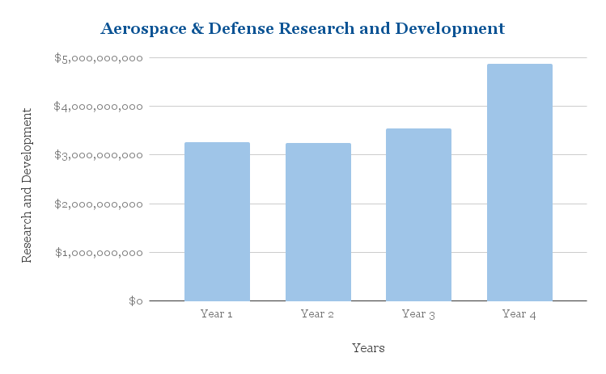
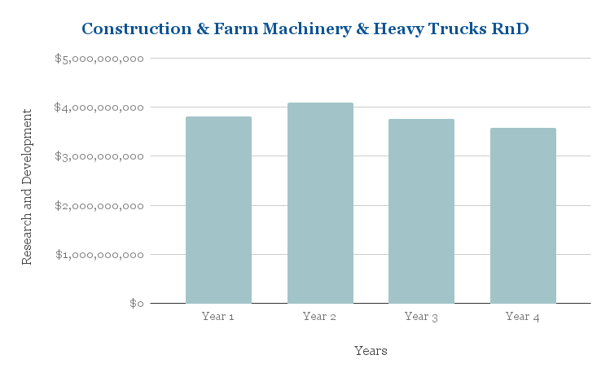
 | Construction & Farm Machinery & Heavy Trucks | Aerospace & Defense
std | 816047162.2 | 1455804515
max | $2,380,000,000 | $4,627,000,000
min | $215,600,000 | $0
range | $2,164,400,000 | $4,627,000,000
mean | $1,268,800,000 | $746,050,000
median | $1,438,550,000 | $0

